Slide 1




WESAIL ~ Wakefield SENDIASS
Wakefield Early Support, Advice, Information and Liaison service
wesail@family-action.org.uk
www.facebook.com/WakefieldWESAILandLocalOffer
01924 965588

Slide 2
Who are we?
We are a statutory service jointly funded by Wakefield Council and Wakefield Integrated Care Board (ICB was CCG)
Service available to parents/carers of a child or a young person, who has, or may have, Special Educational Needs and/or Disabilities (SEND) aged 0-25 years who are living within the Wakefield District
Hybrid working team of 7:
Service Manager
Local Offer Lead & Senior administrator
Senior SENDIASS Officer
3 Part-time SENDIASS Officers
SENDIASS & Admin assistant
Notes:
WESAIL is the umbrella term for our service

Slide 3
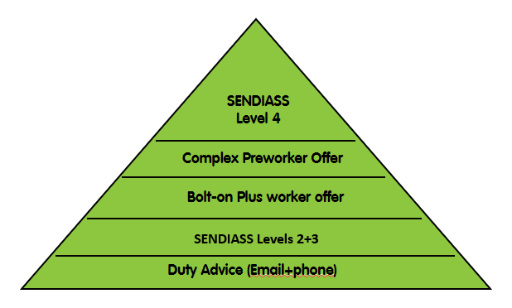
Overview of offer
LOCAL
OF
F
E
R

Slide 4
What are we responsible for?
Providing a free, confidential and ‘impartial’ service
Offering information, advice, support and signposting according to need. This is provided by telephone or email. Where appropriate involvement may increase on an individual or targeted basis
Providing information, advice and support on a wide range of information relating to Special Educational Needs and/or Disabilities (SEND) including education, health, social care, along with signposting to other agencies who can help
Responsible for updating the Local Offer, engaging with children, young people, families and stakeholders in its ongoing development and review
The main element of our service is virtual and signposting support via the duty line (email and voicemails)

Slide 5
What is impartiality?
By law the SENDIASS element of our service must be impartial. This means we do not take sides e.g., between a school and a parent
We are separate to the Council and will signpost to other services
You can read more about us using the WESAIL Working together document or view our working together document online
We are not part of the following:
SENART-Special Educational Needs Assessment and Review Team. 01924 302465 senart@wakefield.gov.uk
WISENDSS - Wakefield Inclusion and SEND Support Service WISENDSS@wakefield.gov.uk
Family HUBs -https://www.wakefieldfamiliestogether.co.uk/family-hubs/
WASP – Wakefield Awareness Support Project 01924 683890
Voiceability – Wakefield Children and Young People Advocacy Service

Slide 6

Duty Advice
Runs 51 weeks of the year during office hours
Access via email or phone (calls are not answered-message service used)
Provide a free, confidential and ‘impartial’ service – which means we do not take sides and try to ensure everyone is given opportunities to express their views and feel listened to
Available to parents/carers, young people and professionals
For specific mental health support please contact
CAMHS https://www.southwestyorkshire.nhs.uk/services/camhs-wakefield/
All requests for service are reviewed by a Single Point of Access (SPA) team. The SPA accepts requests for service 9am – 5pm
01977 735865
Compass Wakefield
https://www.compass-uk.org/services/wakefield-children-and-young-peoples-emotional-health-and-wellbeing-service/
01924 665 093
In an emergency, please seek support from an emergency service
(i.e. by calling 999 or visiting A & E)

Slide 7

Sendiass
Sendiass stands for Special Educational Needs & Disabilities (SEND) information, advice and support service (IASS)
We provide advice, support and case work on a wide range of legalities under SEND code of practice
We follow the minimum standards for IASS
Provide advice to settings on reasonable adjustments
We are separate to the council
Our webpage
https://wakefield.mylocaloffer.org/wesail/
Notes:
Easy read version of Minimum standards available on the LO

Slide 8
Our approach
We mostly provide support to service users via email or phone call. As a small team, we provide calls or emails with information in relation to meetings families may need help with, but we do not often attend
Please note that we operate our duty phoneline using TEAMs. We do not answer telephone calls, and we need you to leave a message to know you have been in contact.
We are not able to provide support at meetings outside of our contracted working hours (9am-5pm on weekdays)
You can find out about what advocacy means for our service on the IASS advocacy definition document
Notes:
Easy read version of Minimum standards available on the LO

Slide 9

SENDIASS Support
Examples include:
Advice on "Reasonable adjustments"
Information on SEND law
How to request an Education Health and Care Plan (EHCP)
Advice on annual reviews
Signposting to other support services
Call before and after a meeting for advice
Information on provisions in Wakefield
For SENDIASS in other areas of the UK
https://councilfordisabledchildren.org.uk/what-we-do-0/networks/information-advice-and-support-services-network/find-your-local-ias-service
Sensory Processing information and resources can be found at https://www.sensoryhelpnow.org/

Slide 10

Pre & Plus Offer
The Pre & Plus offer is provided in two formats:
Complex Pre working cases –for Under 5’s where not yet reached statutory school age
A “Bolt-on” Plus worker offer which will add enhanced support to SENDIASS cases
What we will not be able to offer:
Regular attendance at groups with a family
Attendance at all medical appointments or meetings
Behaviour support
Incontinence/toilet training
Mental health support sessions
Workshops
Emotional support only service
< 5

Slide 11

Complex Pre Worker offer
Referral criteria
3 point Essential criteria
Please note child MUST have seen a paediatrician prior to referral and there needs to be a recognisable additional need identified
There needs to be two or more professionals from specialist agencies already involved with the family prior to referral
For example:
*Paediatrician *Physiotherapy *Occupational Therapy
*Speech Therapy *Dietician *Portage
*Community Nurse *Early Years SEND *Learning Disability Nurse
This offer is for Under 5’s only.
In exceptional cases we will consider over 5’s dependent upon family need and our capacity
**Unfortunately, we do not offer direct behaviour support as part of our service. We recommend a referral to Family HUB/Team around the Early Years**
3. To accept a referral there also needs to be an element of coordination required
For example:
Early Support (Creating a “Family file”, coordinate meetings, coordinate appointments)
Liaison with professionals
Facilitating/attend Multi-agency Meetings

Slide 12

Family Line by Family Action

Slide 13

Local Offer
https://wakefield.mylocaloffer.org/
The local offer website is a legal requirement that provides information and support available for families with children and young people aged 0-25 years with special educational needs and/or disabilities in the Wakefield district

Slide 14

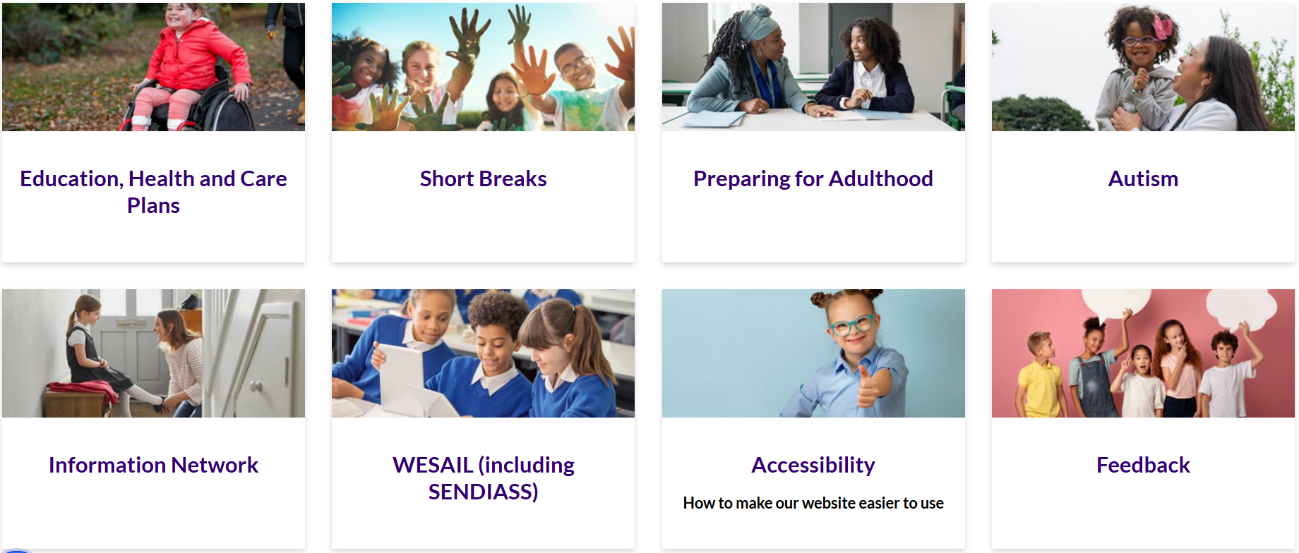
Local Offer Continued

Slide 15

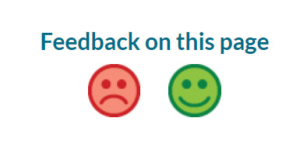

Highlights to remember
How to use this site
Feedback
Accessibility:
Google translate
Font change (size/colour)
Screen readers
My favourites & booklet
Carousel
Notes:
Over 100 languages available for translation

Slide 16
Wakefield's Local Offer is more than just a website
We produce a newsletter known as “News and Views”
We provide support via the Local Offer email inbox
We use social media to provide information and announcements about the Local Offer as well as showcasing other services

Slide 17
News and Views
Is a termly newsletter which features key services, support, activities, events and news about what is available in the local area
Any service can contribute to this
Stories and ideas from parents/carers and young people are also welcomed
Electronic copies are sent via email to those on the Information Network register and to key community spaces to provide service users with a hard copy
Requests for electronic copies can be made via the email below
Shared virtually via our Facebook page
Back copies are available electronically on the local offer website
Contact for the Local Offer inbox
wakefieldlocaloffer@family-action.org.uk
Notes:
If you sign up to the Wakefield Information Network (IN), you get a copy of the newsletter before it appears on the website along with advance details of planned events.
The IN is also the Disabled Children’s Register which the council has a statutory duty to have and keep up to date. The register is voluntary for families to join but helps inform decisions about new and existing services across the Wakefield district.
Practitioners who work with families with children and young people with additional needs can also sign up to the IN to receive an email copy of the newsletter.

Slide 18
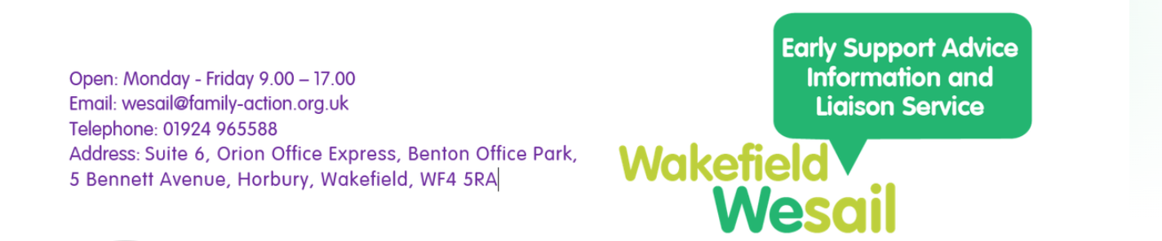

www.facebook.com/WakefieldWESAILandLocalOffer

Slide 19
How can you support us?
Join the LO or ensure your existing information is accurate and up to date
Become a LO Champion
Contribute articles to the “News and views” newsletter
Accurate signposting –if in doubt, check it out via email
Like, follow and share information on our social media site
Join the information network (disabled children’s register) to receive up to date information
See the WESAIL webpage for further information about our SENDIASS Steering group

Slide 20
Thanks for listening!
Wakefield Early Support, Advice, Information & Liaison service
wesail@family-action.org.uk
www.facebook.com/WakefieldWESAILandLocalOffer
https://www.family-action.org.uk/what-we-do/children-families/wesail/
01924 965588

